Slide 1
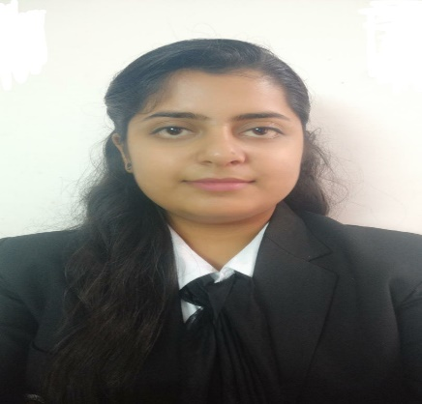



KM Diksha Rai
Analyst/Software Engineer
Bachelor of Technology(CSE)
Batch: 2018-2022
Skills
Java 8 /J2EE | Java Basics, OOPS, Generics, Collections, Arrays, Loops, Lambda Exp, Junit, Mockito.
Spring core | IOC & Dependency Injection, Autowire
Spring REST | REST controllers, Implementation of GET, POST, PUT & DELETE, Bean Validation & Exception Handling, Testing Services, Controller & Repository layer
Spring Data JPA | Implement DAO layer using spring Data repositories, Transaction Management
Spring Boot Microservices | Spring Boot Starters, annotations, Messaging Service, Sync/Async comms, Swagger API documents
Spring Cloud | Eureka, Hystrix
React | Components, Hooks, Event handling, axios
Database | MongoDB No Sql Basics My SQL
UI Tech | HTML 5 & CSS 3,JavaScript, ES6 & TypeScript Reusable templates, Optimized UI Designed
Tools | Git, Postman, Maven, IDE
Devops | CI/CD, Docker
Add On skills | Communications, Team management. Peer learning
NA
diksharai4183@gmail.com
+91 9068428642
NA
Full Stack Developer
Hands on experience in developing web pages using React JS, HTML5, CSS3, Java script, ES6, MongoDB.
Practical understanding of Javascript concepts.
Hands on experience in developing Java Microservice architecture using Spring boot.
Proficient in creating Single page Web Application in React with React Routing.
Practical understanding of React Hooks.
Implemented Spring Boot, React, MongoDB in case study and upskilling knowledge continuously.
Good understanding of testing tools like Mockito, JUnit5.
E-Commerce Shopping Cart Application
Completed end to end case study of Shopping Cart Application along with JWT authentication, Swagger and payment testing using Stripe, responsive UI with Tailwind CSS and Angular used for user interface.
Railway Booking System
Developed Website using HTML, CSS & Javascript.
Toll Plaza management system
Developed using C++
Certfication:
Introduction to AWS (A Cloud Guru)
Check out my work on GitHub and my project here

